Slide 1
Deduplicating Cloud Functions - Sprint 5
Beliz Kaleli | Vikash Sahu | Paritosh Shirodkar | Asutosh Patra
Notes:
‹#›

Slide 2
The Purpose
The purpose of this project is to design and implement a deduplication framework for serverless platform in order to improve overall throughput of the platform.

Slide 3
Recap
Sprint - 1
Familiarizing with Serverless Technology
Sprint - 2
Setting up all the components (Kafka, Minio, CouchDB and OpenWhisk)
Sprint - 3
Developed deduplication framework for Image Thumbnail Use Case in IBM Cloud
Sprint - 4
Generalized our framework by implementing different use cases
Designed our CLI

Slide 4
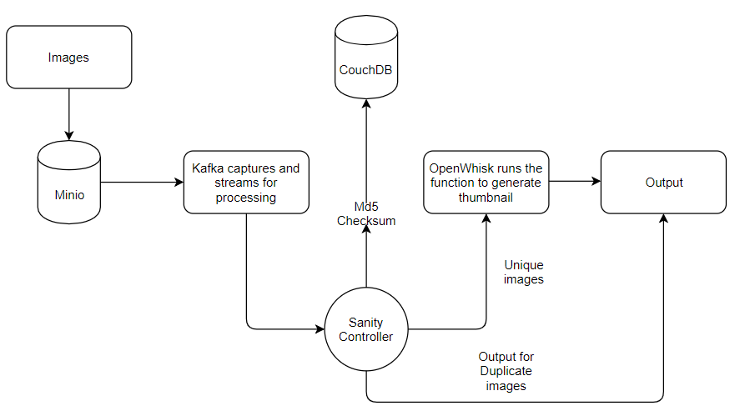
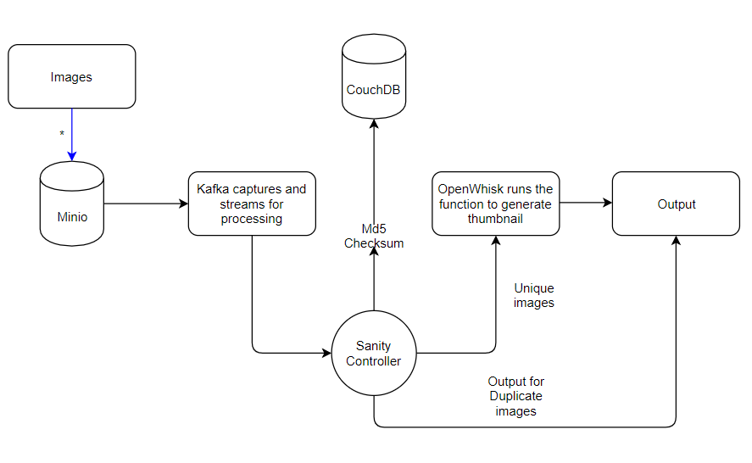
Architecture Diagram
data

Slide 5
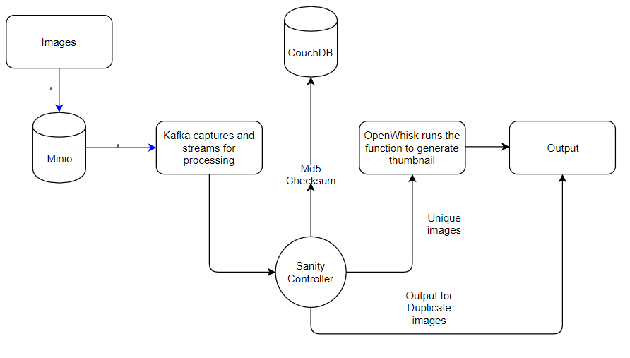
data

Slide 6
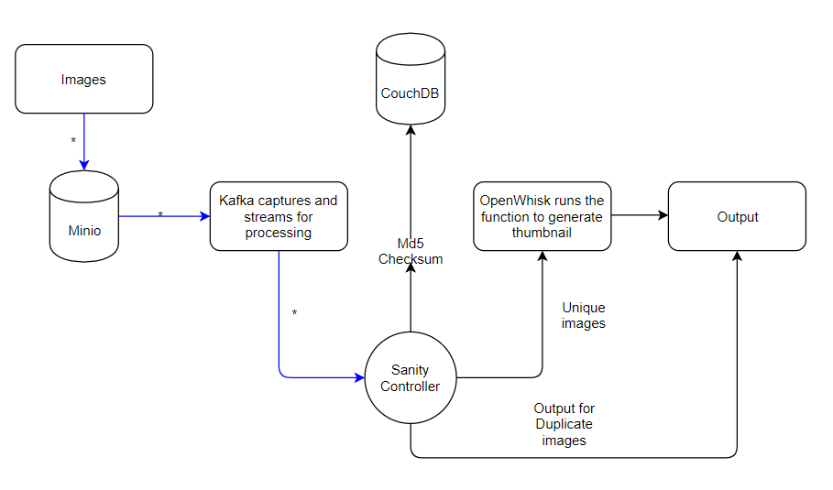
data

Slide 7
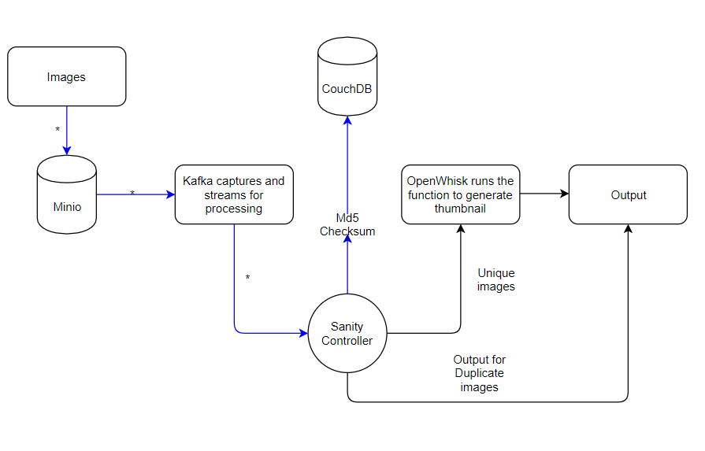
data

Slide 8
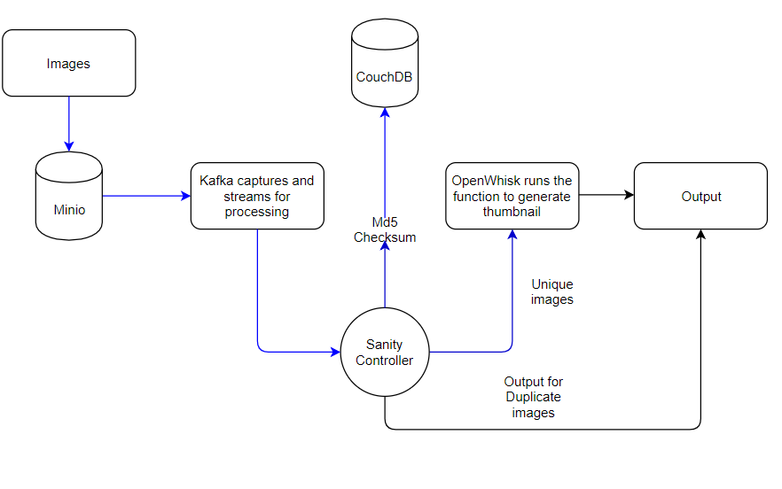
data

Slide 9
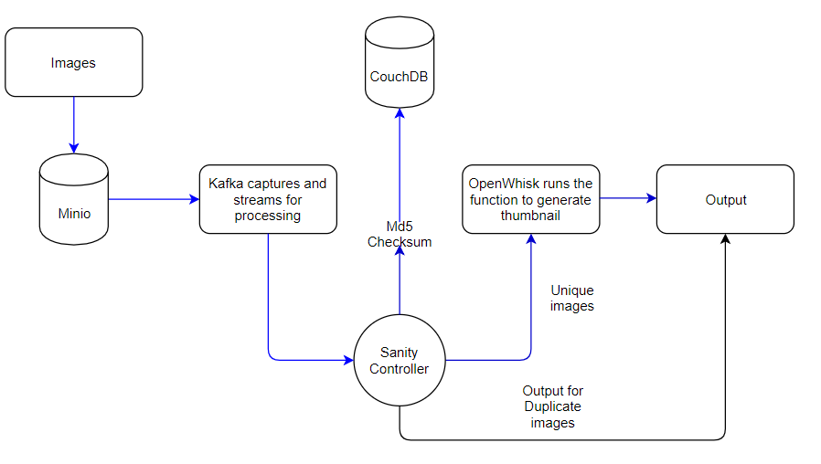
data

Slide 10
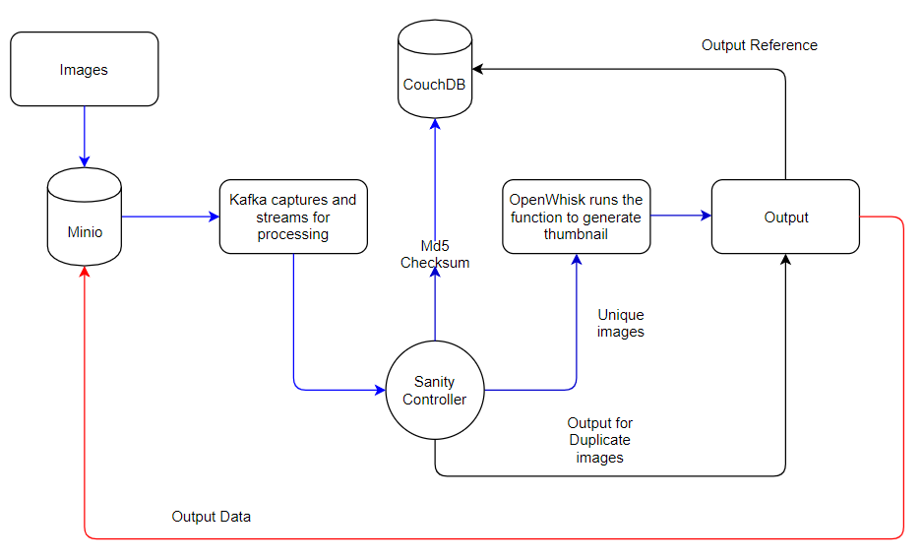
data

Slide 11
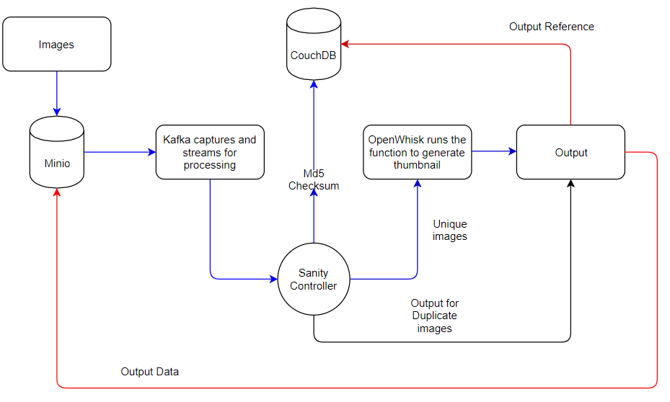
data

Slide 12
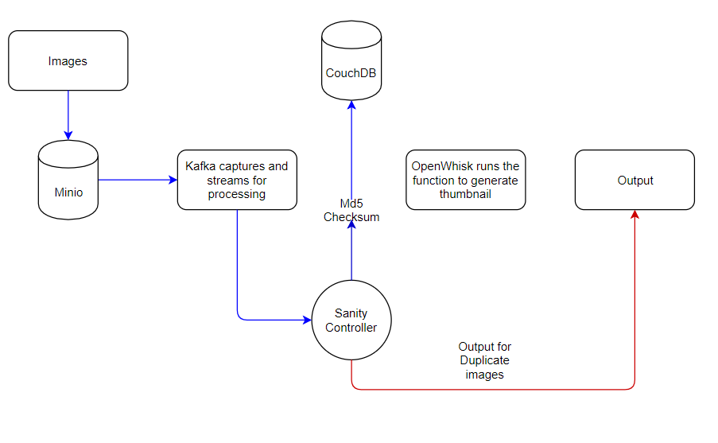
data

Slide 13
What has changed from the Sprint - 4
Then,
Support for Single User - Multi Use Cases
sanity --i <input_bucket> --o <output_bucket> --f <function_name>
Now,
Support for Multi User - Multi Use Cases
sanity --i <input_bucket> --o <output_bucket> --f <function_name> --u <user_name>

Slide 14
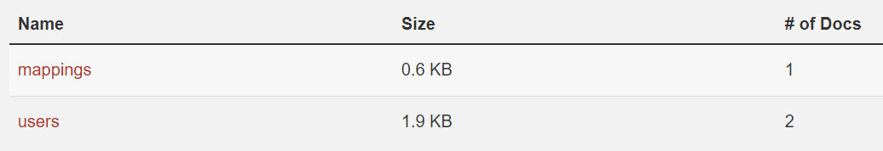
New Schema for CouchDB
2 DBs:
Mappings: Username and document id mappings
Users: User documents

Slide 15
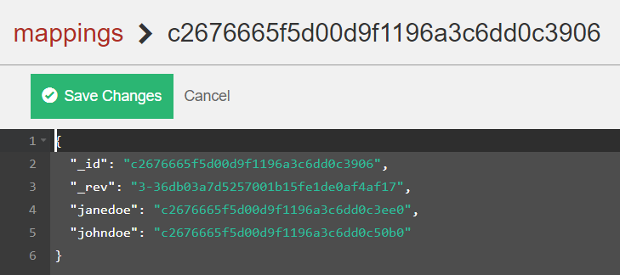
Mappings DB

Slide 16
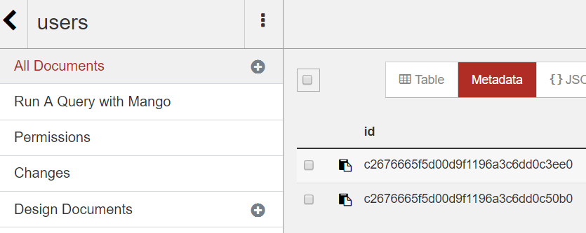
Users DB
Doc of Jane Doe
Doc of John Doe

Slide 17
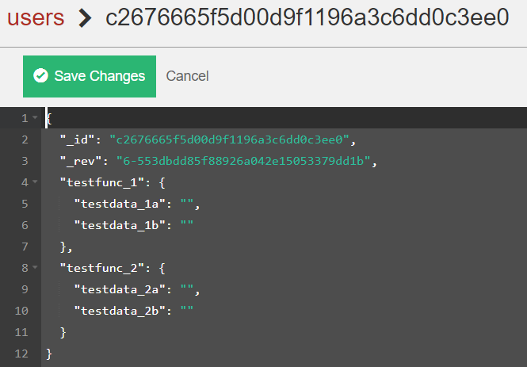
Document of Jane Doe

Slide 18
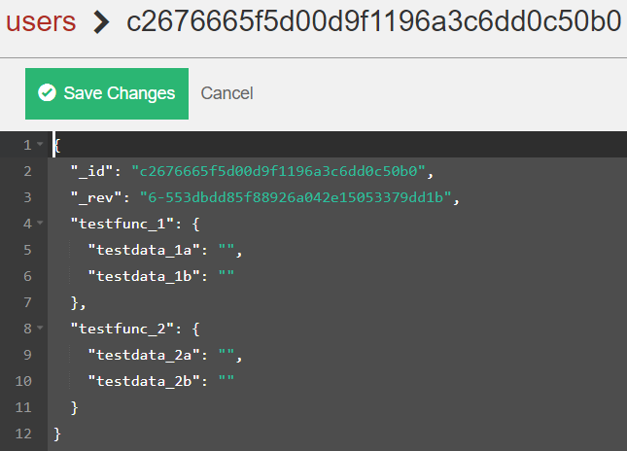
Document of John Doe

Slide 19
A Quick Recap

Slide 20
Function
Create
User
OpenWhisk
Deploy

Slide 21
sanity --i input --o output --f function --u user
User
Create User if not present
Output
Input
Sanity
Waits
Data

Slide 22
Data
Sanity
Calculates Checksum
Duplicate Data
Unique Data
Output
OpenWhisk

Slide 23
DEMO

Slide 24
What did we achieve in this sprint?
Designed and developed our database to handle multiple users
Developed CLI
Demonstrate how fast de duplication would be(covered in Demo)

Slide 25
Challenges in Current Sprint
Integrating CLI with the existing pipeline
Debugging actions inside the openwhisk
Building a multi user interface with CLI

Slide 26
Future Scope
User authentication
Support for multi threading
Generalizing sanity to support multiple serverless platforms

Slide 27
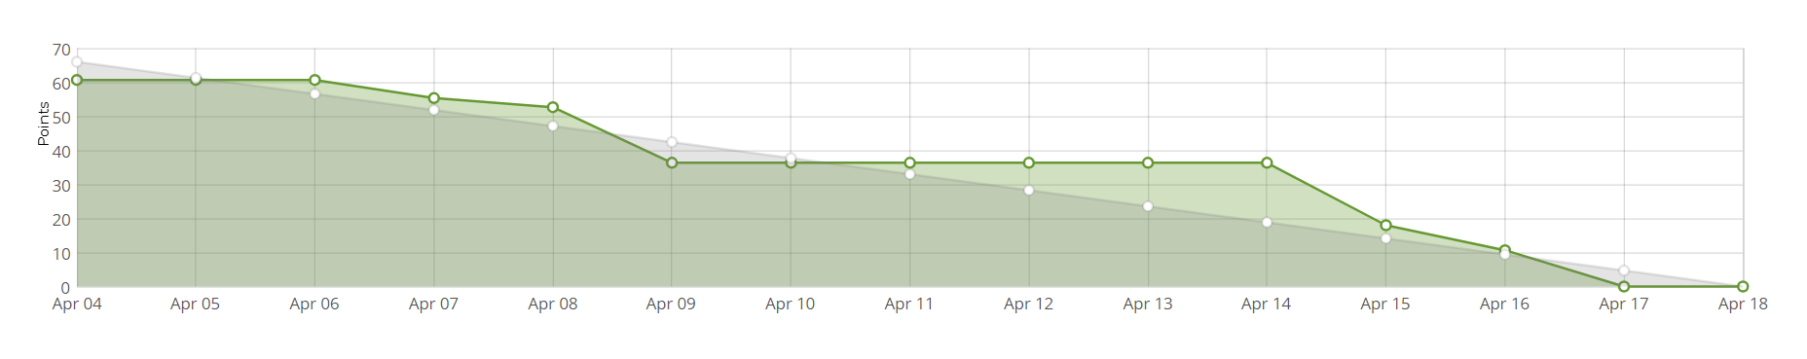
Burndown Chart

Slide 28
THANK YOU

